Slide 1

Project 3: Ensemble techniques Travel Package Purchase Prediction
University of Texas at Austin – Mc Combs school of business
Post Graduate program in AI & Machine Learning: business applications
Rémi MAILLON

Slide 2
Context and objectives
Data scientist for a tourism company named « Visit with us »
Company wants to enable and establish a viable business model to expand the customer base by introducing new offering of packages.
Last year, only 18% of potential customers purchased the packages.
The company is now planning to launch a new wellness tourism package.
By analyzing available data, objectives are to:
Build a model in order to predict which customer is more likely to purchase the newly introduced travel package.
Make marketing expenditure more efficient by targeting potential customers more effectively.

Slide 3
Data set overview

Slide 4
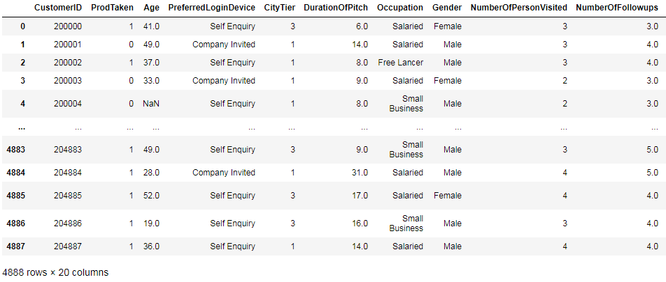
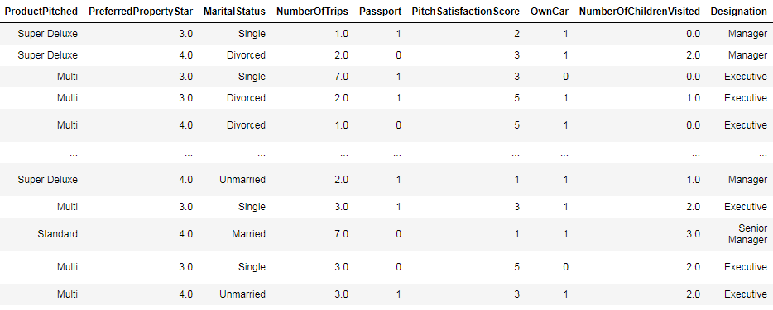

Data set overview
4888 rows and 20 columns
Data includes both numerical and categorical variables
Some null values
Some outliers

Slide 5
Data set overview
 | count | mean | std | min | 25% | 50% | 75% | max
ProdTaken | 4888 | 0.188 | 0.390 | 0.0 | 0.0 | 0.0 | 0.0 | 0.0
Age | 4662 | 37.622 | 9.316 | 18.0 | 31.0 | 36.0 | 44.0 | 61.0
CityTier | 4888 | 1.654 | 0.916 | 1.0 | 1.0 | 1.0 | 3.0 | 3.0
DurationOfPitch | 4637 | 15.490 | 8.519 | 5.0 | 9.0 | 13.0 | 20.0 | 127.0
NumberOfPersonVisited | 4888 | 2.905 | 0.724 | 1.0 | 2.0 | 3.0 | 3.0 | 5.0
NumberOfFollowups | 4843 | 3.708 | 1.002 | 1.0 | 3.0 | 4.0 | 4.0 | 6.0
PreferredPropertyStar | 4862 | 3.581 | 0.798 | 3.0 | 3.0 | 3.0 | 4.0 | 5.0
NumberOfTrips | 4748 | 3.236 | 1.849 | 1.0 | 2.0 | 3.0 | 4.0 | 22.0
Passport | 4888 | 0.290 | 0.454 | 0.0 | 0.0 | 0.0 | 1.0 | 1.0
PitchSatisfactionScore | 4888 | 3.078 | 1.365 | 1.0 | 2.0 | 3.0 | 4.0 | 5.0
OwnCar | 4888 | 0.620 | 0.485 | 0.0 | 0.0 | 1.0 | 1.0 | 1.0
NumberOfChildrenVisited | 4822 | 1.187 | 0.857 | 0.0 | 1.0 | 1.0 | 2.0 | 3.0
MonthlyIncome | 4655 | 23619.8 | 5380.6 | 1000.0 | 20346.0 | 22347.0 | 25571.0 | 98678.0

Slide 6
Exploratory Data Analysis

Slide 7
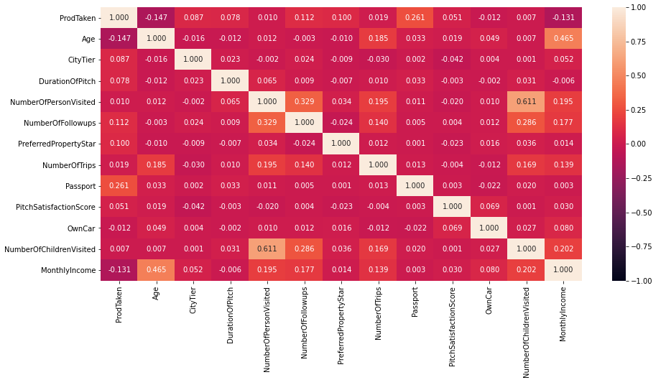
Correlations between variables

Slide 8
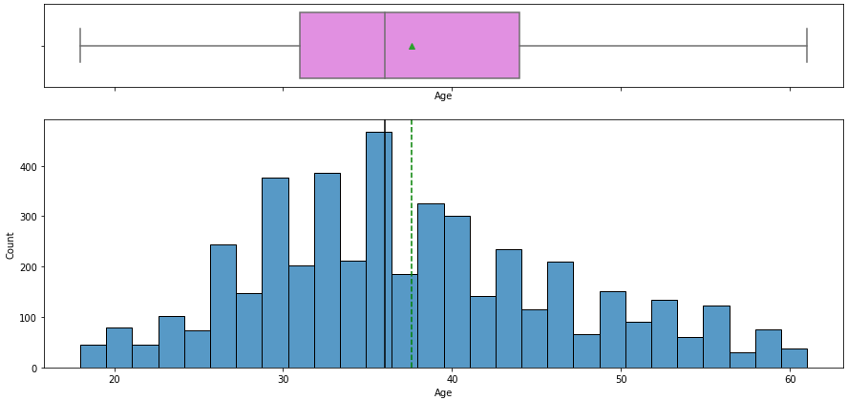
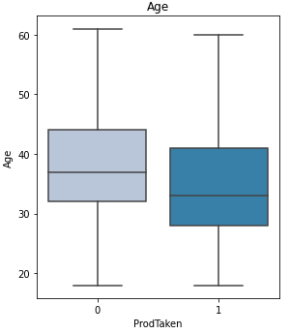
Age of customers
The distribution of age is slightly right-skewed.
Age of customers is ranging from 18 to 61 with an average of 37.6 and a median of 36 years old.
People who purchased the product were younger on average than those who declined it (34.8 vs 38.3 years old on average). Our marketing strategy should therefore focus on younger people.

Slide 9
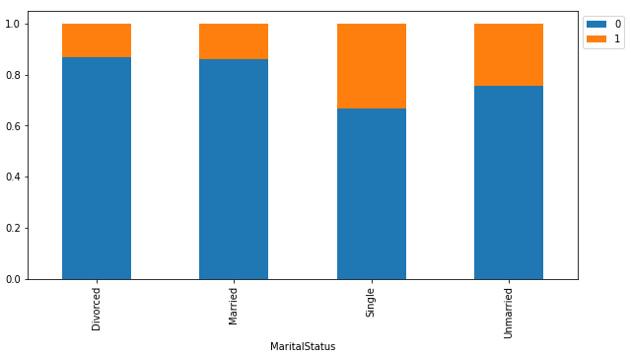
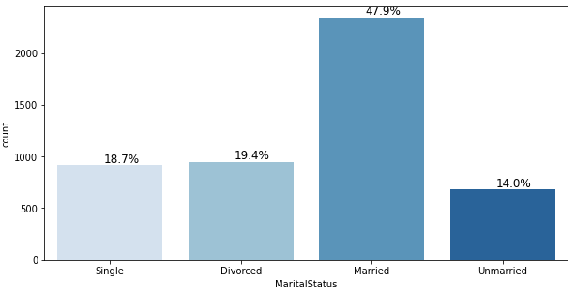
Marital status
Among the 4,888 potential customers in the data set: 47.9 % of them were married, 19.4% divorced, 18.7% single and 14% unmarried.
The proportion of people purchasing the product is greater among single people than married people with a share of 33.2 % vs 13.9% respectively.
Our marketing strategy should therefore focus on single people.

Slide 10
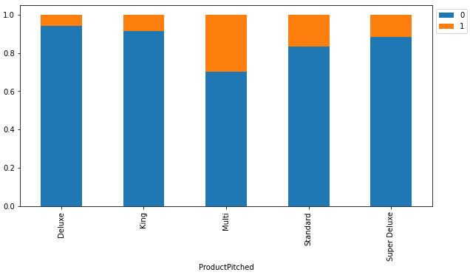
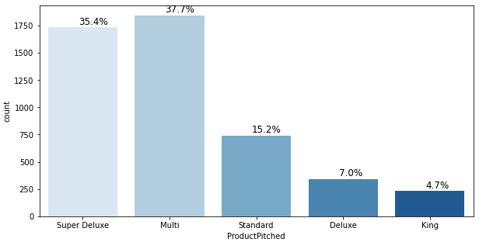
Product pitched
The multi and standard seems to be the most popular products among customers with 30% and 16.7% of people respectively purchasing the product.
Although 35.4% of the time product pitched was the Super Deluxe package, this product does not seem very popular among customers as only 11.8% of people purchased it.

Slide 11
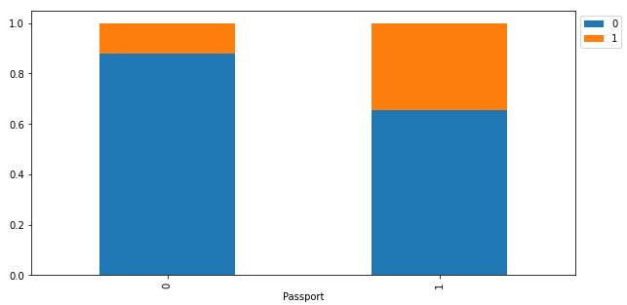
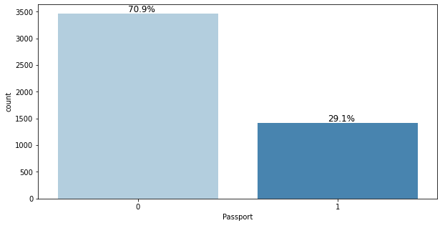
Passport
The proportion of customers purchasing the product is greater among the people having a passport: 34.7% vs 12.3%.

Slide 12
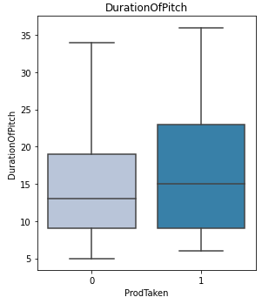
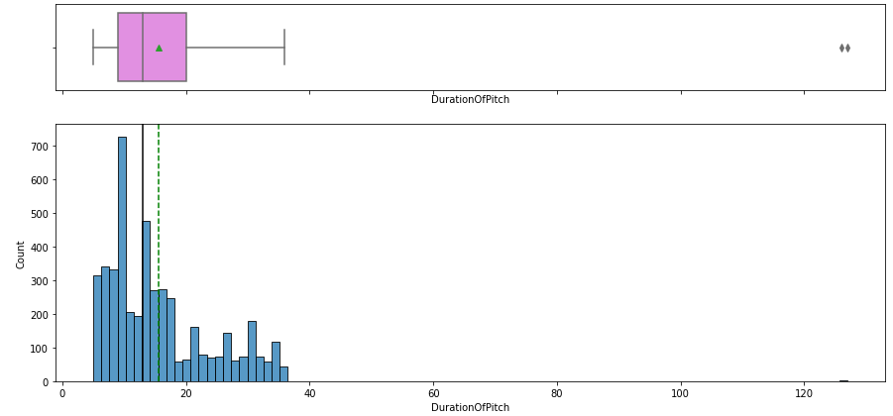
Duration of pitch
The distribution of duration of pitch is right-skewed
The two outliers (126 and 127 minutes) could be the result of a typo.
Average duration of the pitch is 15.5 minutes with a median of 13 minutes.
Most pitches are ranging between 5 and 36 minutes.
The duration of pitch seems to have an impact on the likelihood of the customer purchasing the product as the duration of pitch was longer for those who purchased the product (16.9 vs 15.2 minutes on average).

Slide 13
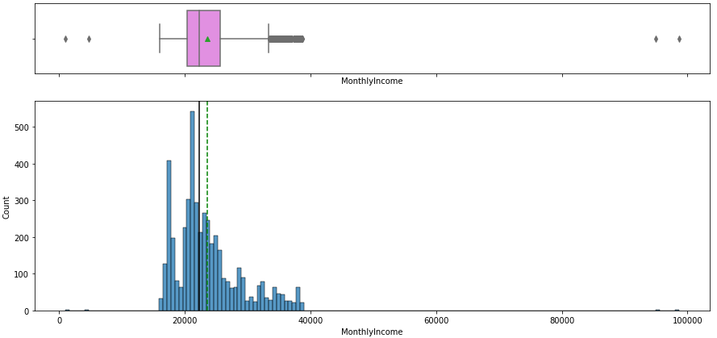
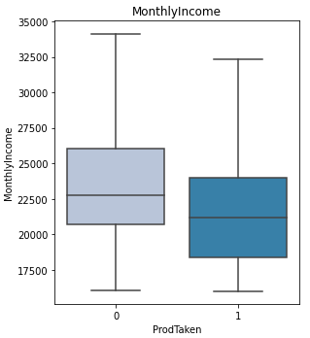
Monthly income
The distribution of monthly income is right-skewed.
Most customers have monthly income ranging between 16,009 and 38,677 with an average of 23,620 and a median of 22,347.
There seem to be four outliers in the data.
As surprising as it may seem, people who purchased the product have on average a slightly lower salary than those who did not purchased the product. This could be explained by the fact that they are also younger.

Slide 14
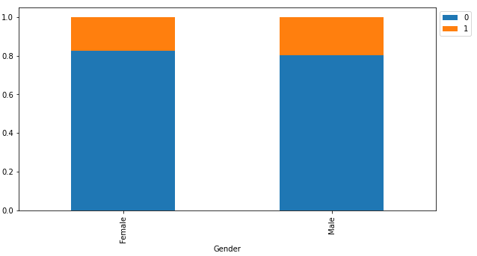
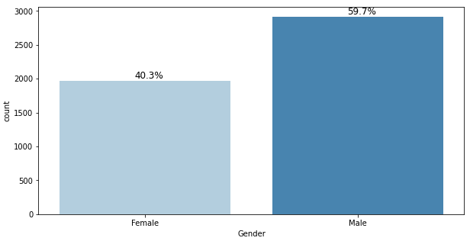
Gender
There are no significant difference between men and women in terms of likelihood of purchasing the product.

Slide 15
Data preprocessing

Slide 16
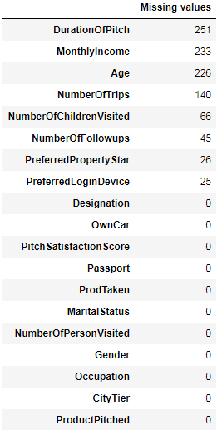
Treatment of missing values and outliers
Missing values have been replaced using the mean in the case of numerical variables and labeled as “unknown” in the case of categorical variables
Although we have already identified outliers in the number of trips, duration of pitch and monthly income columns, it is not necessary to treat them as the impact of outliers on decision trees type algorithms is negligible

Slide 17
Label Encoding and data set split
One hot label encoding for gender variable (male vs female)
Other categorical variables have been replaced as follows:
PreferredLoginDevice: {"unknown": 1, "Self Enquiry": 2 ,"Company Invited": 3}
ProductPitched: {"Multi": 1, "Standard": 2 , "Super Deluxe": 3, 'King': 4, 'Deluxe': 5}
Designation: {'Executive': 1, 'Senior Manager': 2, 'Manager': 3, 'VP': 4, 'AVP': 5}
Occupation: {'Free Lancer': 1, 'Large Business': 2, 'Small Business': 3, 'Salaried': 4},
MaritalStatus: {'Single': 1, 'Unmarried': 2, 'Married': 3, 'Divorced': 4}
70% / 30% split of data set for model training and testing respectively.

Slide 18
Models

Slide 19
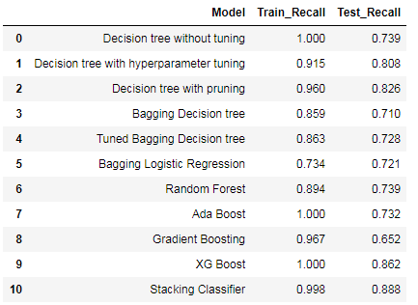
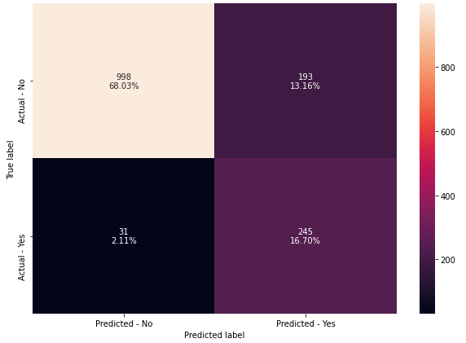
Models performance
11 kind of machine learning models have been tested for purchase prediction including: decision trees, bagging classifiers (decision tree and logistic regression), random forest, ada boost, gradient boosting, XG boost and stacking classifiers.
Models performance has been evaluated based on recall with the best performance achieved with a Stacking Classifier (88.8% of recall on test set)
Confusion matrix for stacking classifier

Slide 20
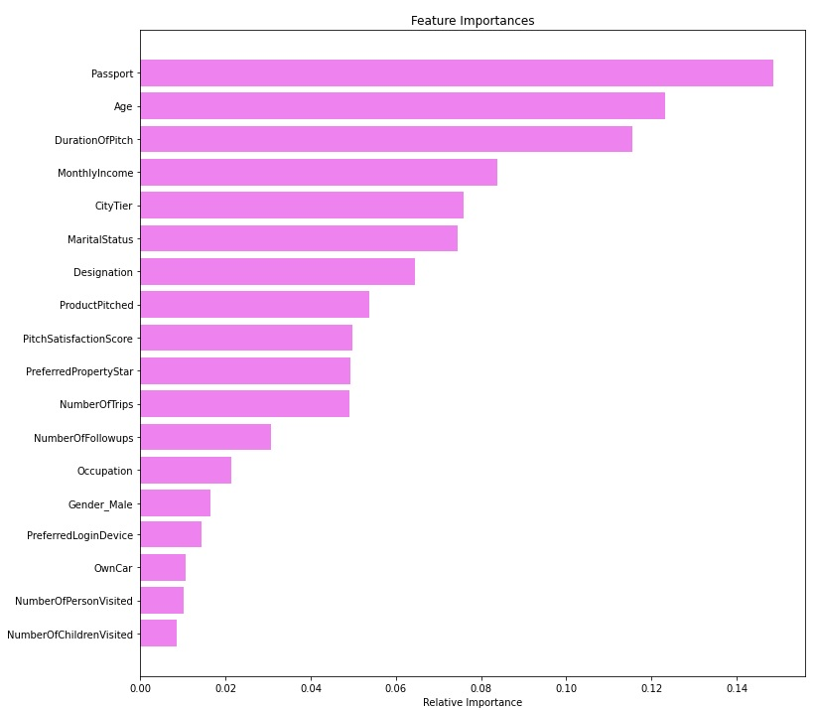
Feature importances (random forest)

Slide 21
Conclusions and recommendations

Slide 22
Business recommendations
It is recommended to modify the marketing strategy in order to target younger and single customers
Customers owning already a passport are alson more likely to purchase the package.
The multi and standard packages are among the most popular. Less focus should be put on pitching the super deluxe product
There is no real difference between men and women in terms of likelihood of purchasing the product.

